Slide 1


Columbia Asia Hospital Analysis
Puja Chowdhury
07/05/2025

Slide 2

Problem Statement
You have been hired as a consultant data analyst by Columbia Asia Hospital. The Hospital is looking for key insights for the following objectives:
Assess the hospital's revenue generation
Insights about suitable departments for new hires
Strategies suggestions for patient discounts

Slide 3
Data Overview
Date: This column contains date and time information without specifying AM or PM. The format is DD-MM-YYYY HH:MM.
Patient ID: Each patient is assigned a unique identifier, which seems to be in the format 124-62-3289.
Patient Gender: This column records the gender of the patient, denoted by 'M' for male and 'F' for female.
Patient Age: The age of the patients is listed in years.
Patient Sat Score: It seems to represent a satisfaction score given by or for the patient. However, the scores are single-digit, and it's not clear what the scale is.
Patient First Initial: This column contains the first initial of the patient's first name.
Patient Last Name: The surname of the patient is listed in this column.

Slide 4
Data Overview
Patient Race: The racial or ethnic background of the patient is recorded here, with categories such as 'White', 'African American', 'Asian', 'Native American/Alaska Native', and 'Two or More Races'.
Patient Admin Flag: This column contains boolean values ('TRUE' or 'FALSE') which might indicate whether the patient was admitted or some other administrative flag.
Patient Wait Time: Appears to indicate the time the patient waited, possibly in minutes, before being seen or processed.
Department Referral: This column lists the department to which the patient was referred, with entries such as 'General Practice', 'Orthopedics', 'Gastroenterology', or 'None' indicating no referral.
Doctor Name: Identifies the doctor who attended each patient.
Appointment Fees: The cost charged for a doctor's consultation.
Total Bill: The overall amount billed to the patient, including all services and charges.

Slide 5
Methodology
Data Loading and Transformation: Loaded data into Power BI, transformed it using Power Query, and performed data cleaning to ensure consistency and accuracy.
Measure Creation: Developed numerous measures using DAX functions, including calculated columns, filters, aggregation functions (SUMX), and time intelligence calculations.
Visualization Creation: Designed various visuals such as bar charts, column charts, cards, gauges, and pie charts to effectively present insights.
Dashboard and Interaction: Utilized features like edit interactions, slicers, and drill-throughs to create an interactive dashboard and comprehensive report.

Slide 6
Data Cleaning Process
Replaced null values in the Satisfaction Score column with the mean to ensure accurate analysis.
Created a Calendar Table from the date column and built a relationship model for time-based analysis.
Checked for null values across the dataset to identify and address data gaps.
Verified data types for consistency and ensured there were no errors in the columns.
Performed all cleaning tasks in Power Query, then applied the changes using the Close & Apply feature.

Slide 7
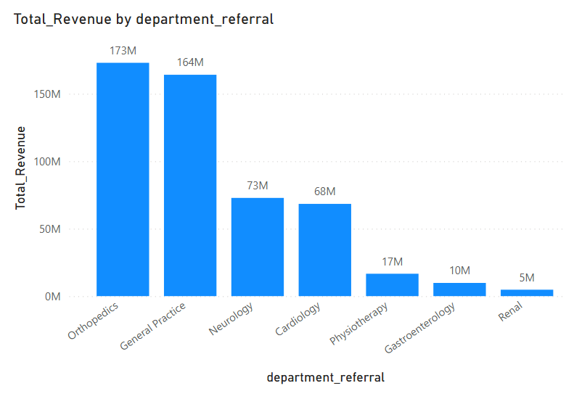
Department-wise Revenue Performance Evaluation
The Orthopedics Department recorded the highest total revenue among all departments, generating 173 million.
The Renal Department had the lowest total revenue, contributing just 5 million.

Slide 8
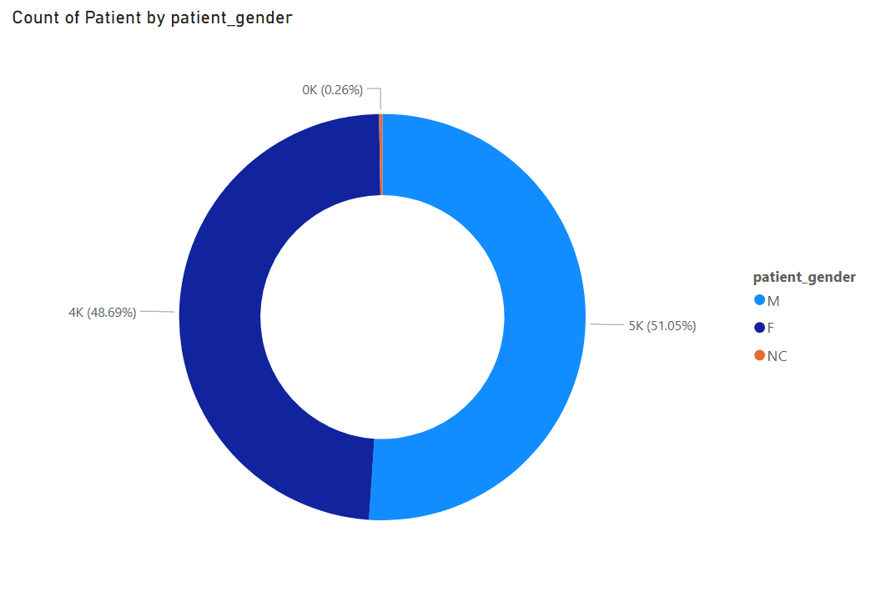
Gender-wise Analysis of Patient Visits
Patient visits are nearly evenly split between males (51.05%) and females (48.69%), indicating no strong gender bias in hospital visitation rates.
A minimal proportion of visits (0.26%) fall under the "Not Categorized" (NC) group.
The donut chart effectively illustrates the close parity between male and female patient visits.

Slide 9
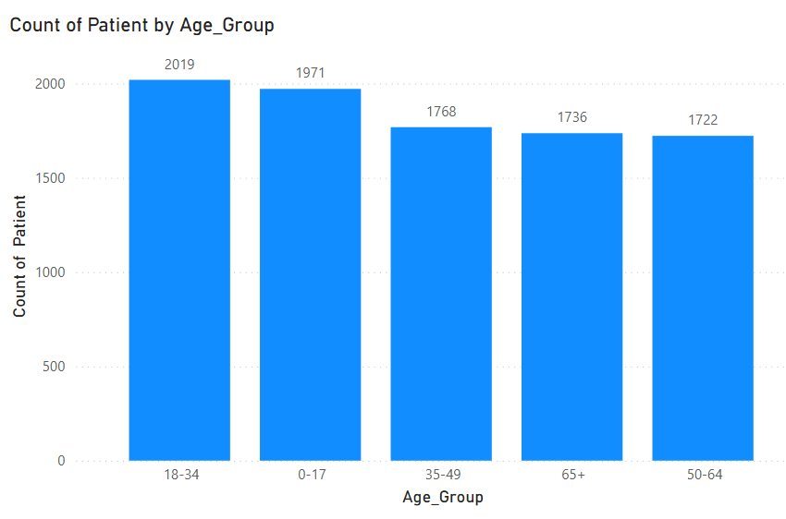
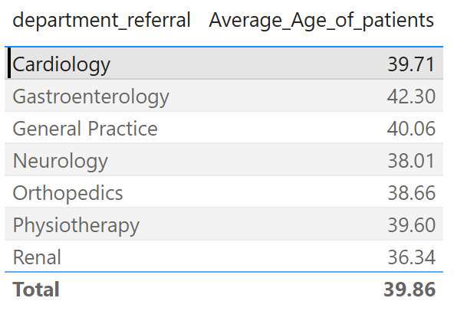
Patient Visits and Age Demographics Analysis
Age group 18–34 recorded the highest number of visits, suggesting this demographic is the most active in seeking healthcare services.
The SWITCH function was used to segment patients into age groups for better comparison and trend analysis.
A table visual display department-wise averages, offering targeted insights across specialties.

Slide 10
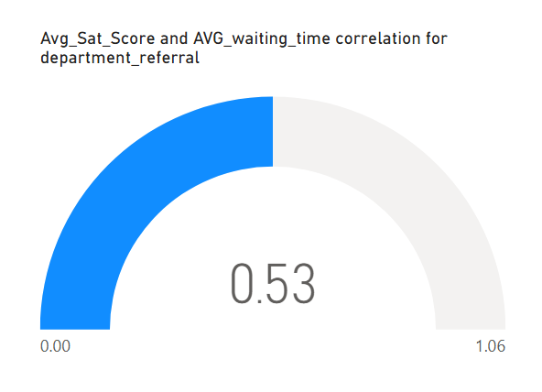
Impact of Wait Time on Patient Satisfaction
A moderate positive correlation of 0.53 was found between patient wait time and satisfaction scores, suggesting longer waits may lower satisfaction.
The Gauge Chart visualization visualizes the strength of this relationship within a clear range.
Other factors like staff interaction, care quality, and communication also play key roles in patient satisfaction.

Slide 11
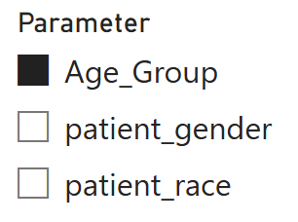
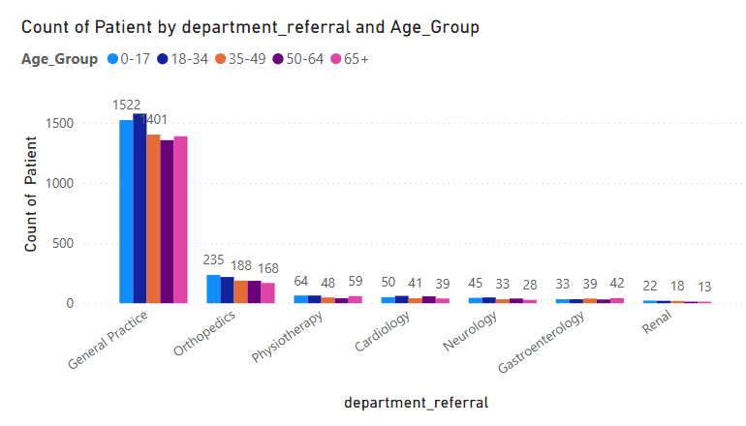
Demographic Influence on Department Visit Frequency
The Stacked Column Chart enables a comparative view of patient counts across departments segmented by demographics.
Field Parameters enable dynamic filtering to explore the impact of each demographic variable.
Analysis indicates that demographics have minimal impact on visit frequency, department visits are primarily driven by health conditions and hospital location.

Slide 12
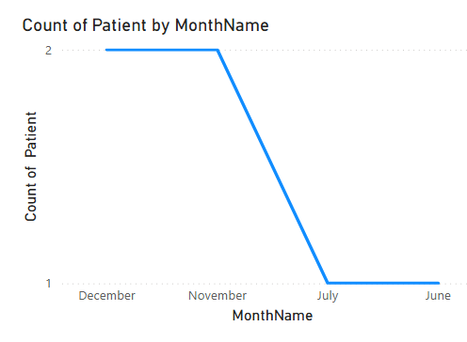
Yearly Trend Analysis of Patient Visit Volumes
A Line Chart with a Year-Month hierarchy visualizes patient visit trends over time.
It supports detailed time-based analysis of fluctuations in visit frequency.
Trends may reflect factors like growing healthcare awareness, service expansion, or the impact of the COVID-19 pandemic.

Slide 13
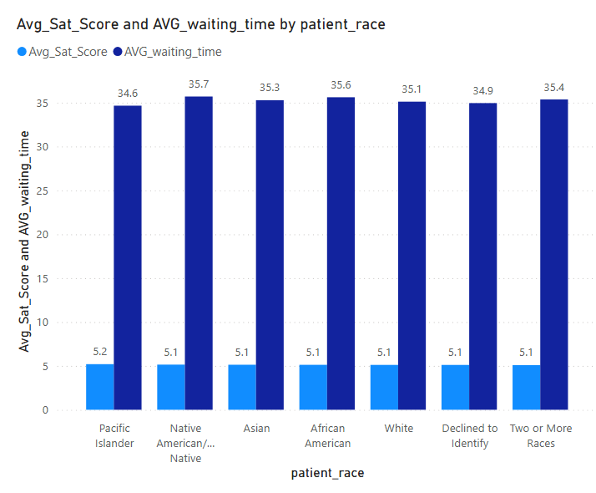
Equity Analysis of Patient Experience by Race and Gender
A Clustered Column Chart with a Field Parameter enabled dynamic comparison of average wait times and satisfaction scores across race and gender groups.
The analysis showed no significant disparities between groups.
This indicates the hospital provides equitable, non-discriminatory care across demographics.

Slide 14
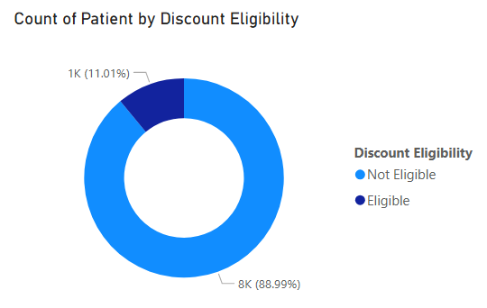
Discount Eligibility Analysis Based on Patient Billing and Satisfaction
Patients with a Total Bill ≥ ₹10,000 and Satisfaction Score ≥ 6 were marked as Eligible for discounts.
A Donut Chart shows only 11.01% qualified, reflecting a selective, performance-based strategy.
This method encourages loyalty and spending while ensuring fairness through measurable criteria.

Slide 15
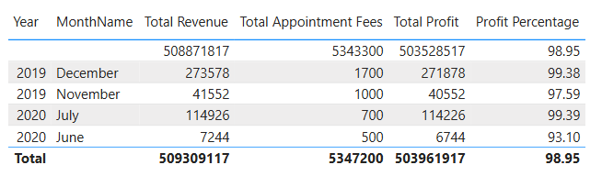
Hospital Profitability Assessment
Profit margins consistently exceeded 97%, with peaks around 98.95%, reflecting exceptionally strong financial performance.
High revenue paired with relatively low appointment-related costs results in significant profit generation.
The analysis confirms the hospital’s operational efficiency and overall financial stability.

Slide 16
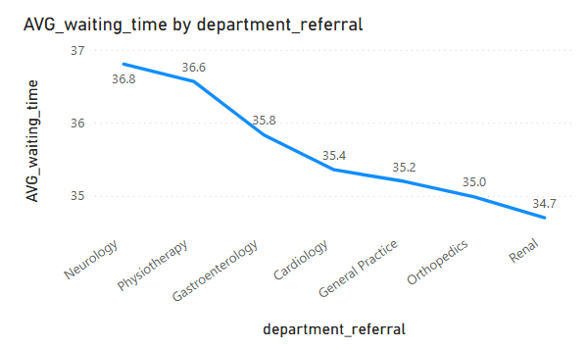
Department-wise Waiting Time Analysis
A Line Chart comparing departments by average waiting time highlighted significant variation in patient wait durations.
Neurology had the highest average wait time at 36.80 minutes.
This points to possible bottlenecks in Neurology, suggesting a need to review demand, staffing, or scheduling.

Slide 17
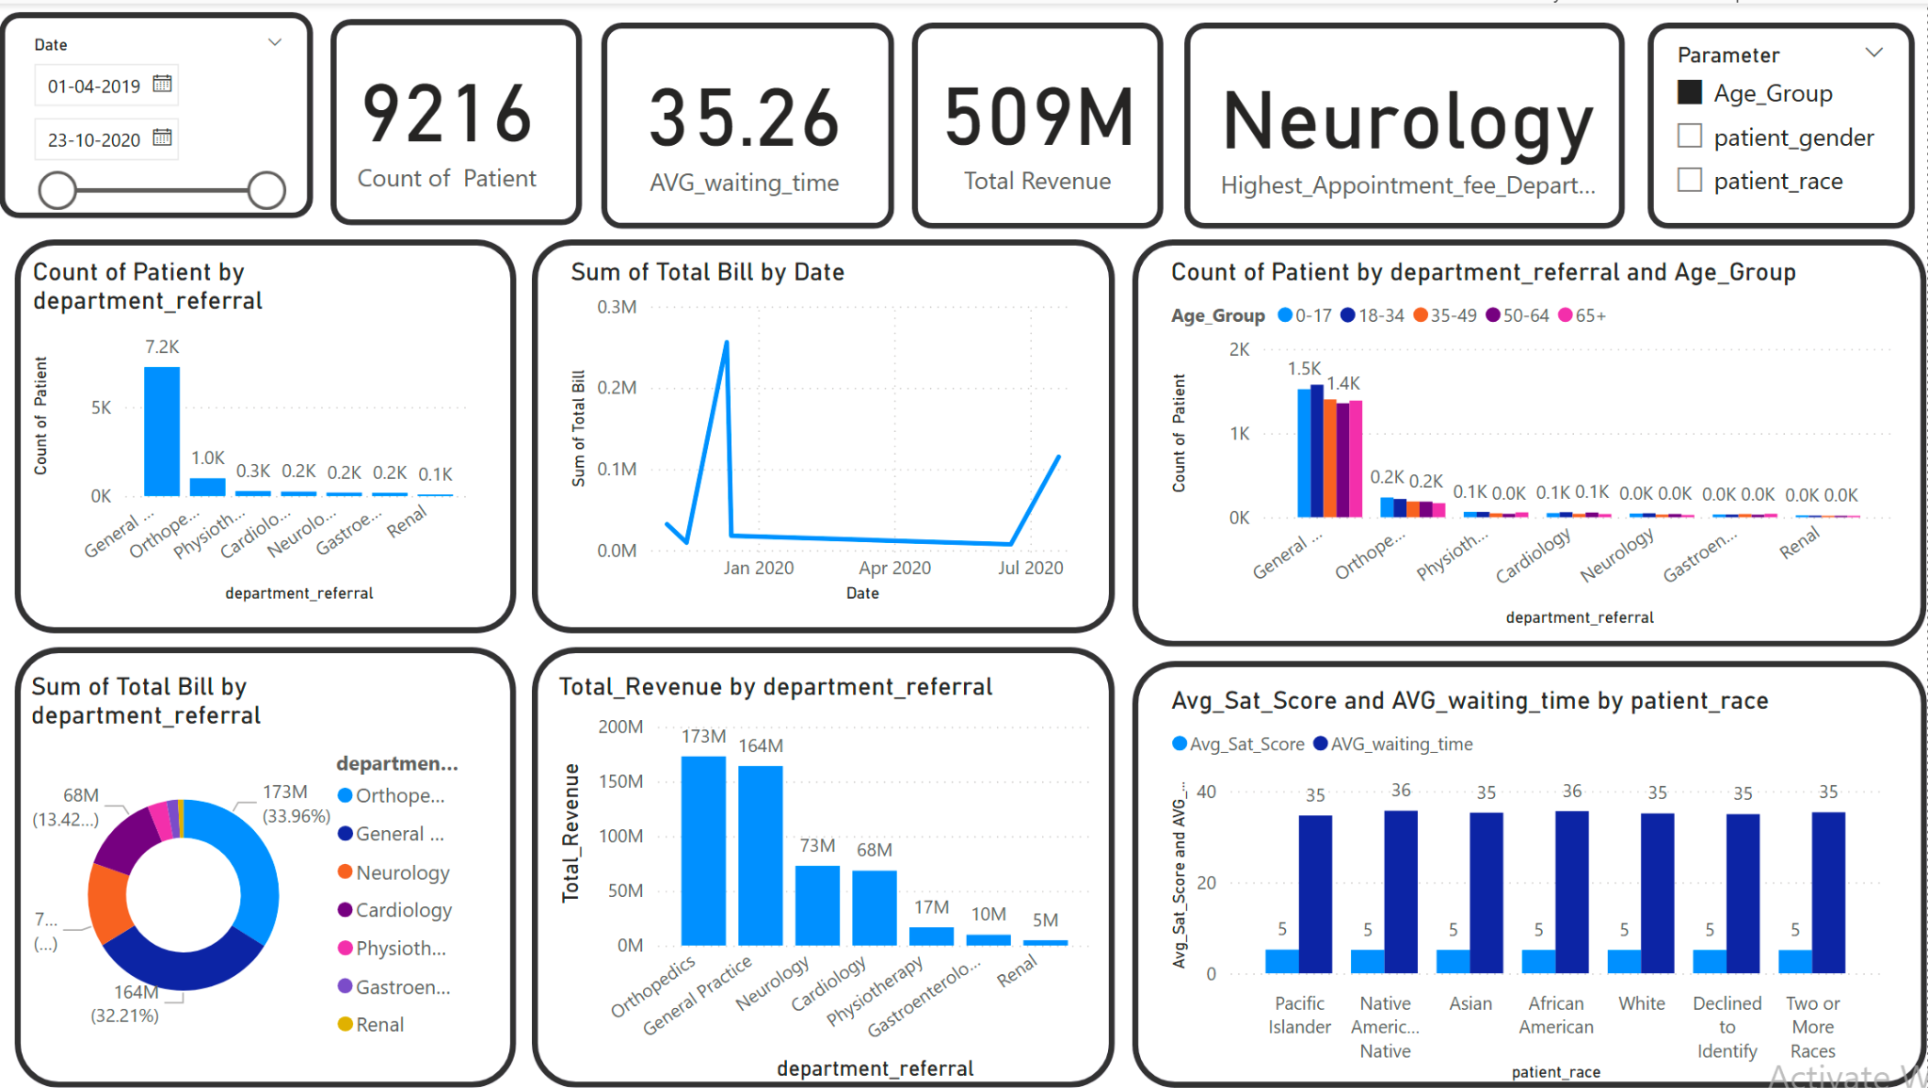
Main Tab

Slide 18
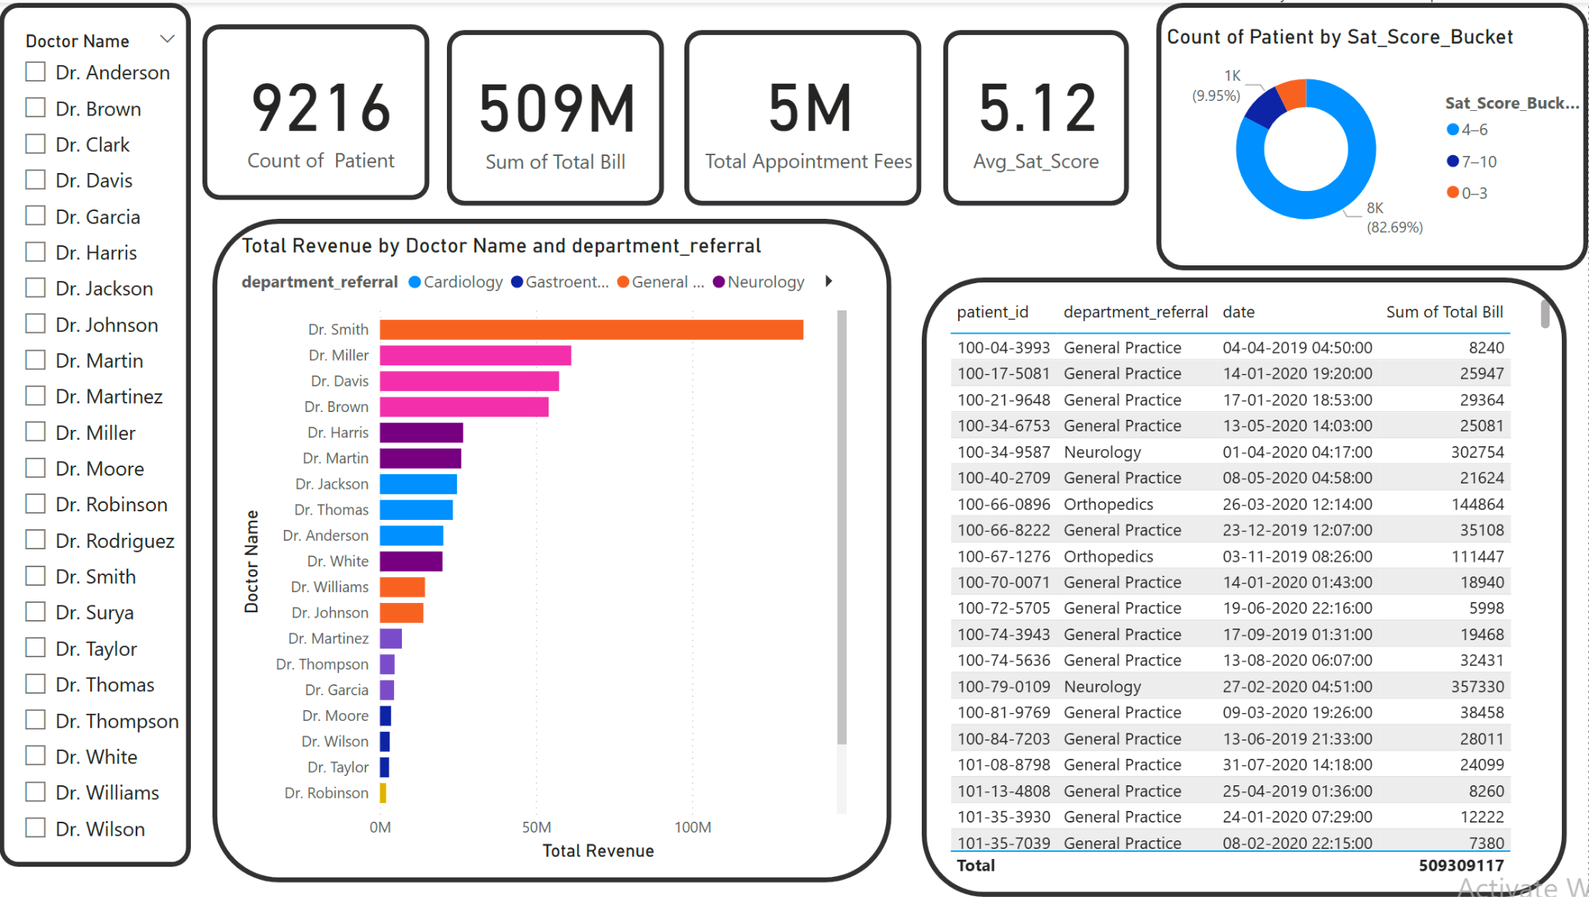
Doctor’s Tab

Slide 19
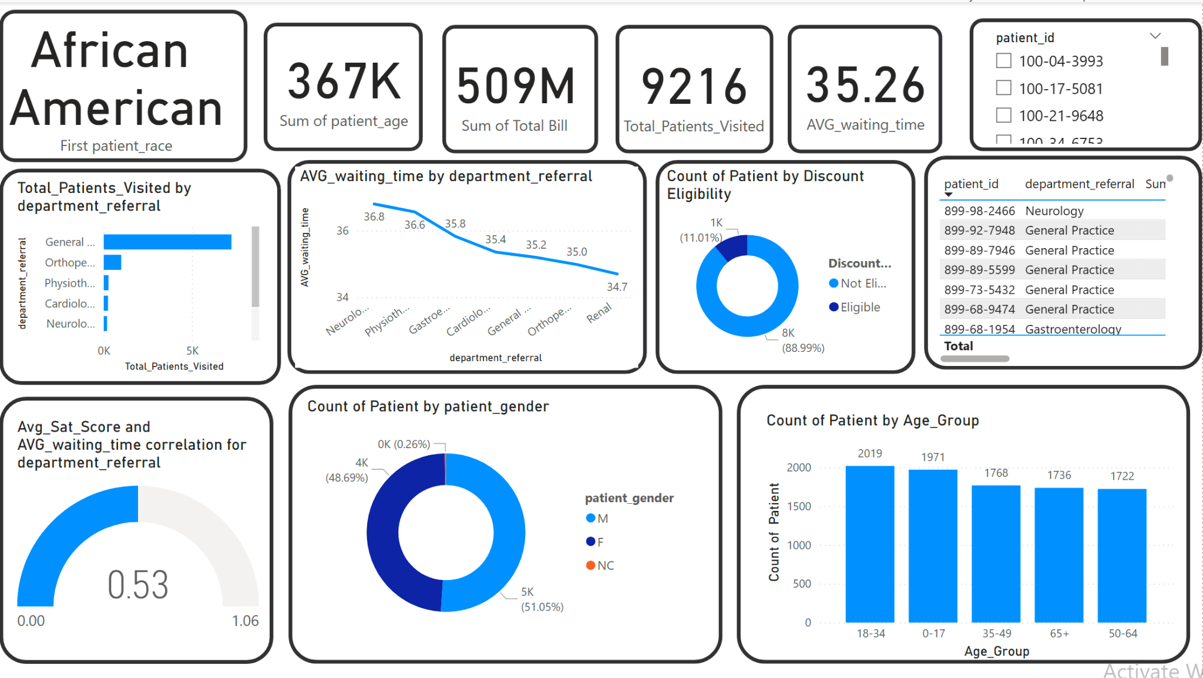
Patient’s Tab

Slide 20
Conclusion: Strategic Path Forward
User Engagement Strategies
Enhance efficiency in high-demand departments to improve patient flow.
Implement satisfaction-focused initiatives to boost patient experience.
Use targeted discounts to increase loyalty and retention.
Customize services based on patient needs and demographics.
Invest in staffing and data-driven strategies for long-term growth.
Strengthen the hospital’s position as a trusted healthcare provider.

Slide 21


